Slide 1
Function declarations
AKA semantic equations

Slide 2
Syntax
declaration ::= funDec
funDec ::= “fun” funEquationList
funEquationList ::= funEquation “|” funEquationList
| funEquation
funEquation ::= id paramList “=“ funBody
funBody ::= expression
paramList ::= param paramList | param
param ::= matchPattern

Slide 3
Traditional usage
fun sq x = x * x;
fun square (x) = x * x;
fun abs x = if x < 0 then ~x else x;
fun sumTuple (x,y) = x + y;
fun sqTuple (x, 0) = 0
| sqTuple (0, y) = 0
| sqTuple (x, y) = x * y;
Note that the matchPattern (x,y) constitutes a SINGLE parameter.

Slide 4
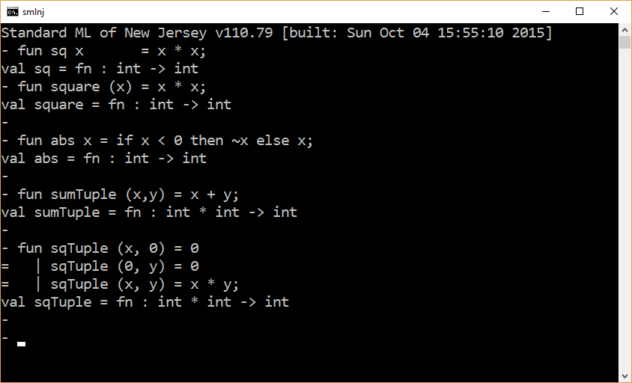

Slide 5
Matching and non-matching equivalences
fun sqTuple1 (x, 0) = 0
| sqTuple1 (0, y) = 0
| sqTuple1 (x, y) = x * y;
fun sqTuple2 (x,y) =
if y = 0 then 0
else if x = 0 then 0
else x * y;

Slide 6
Evaluation order
fun sqTuple (x, 0) = 0
| sqTuple (0, y) = 0
| sqTuple (x, y) = x * y;
Let sqTuple(e1,e2) denote a call to the function sqTuple. The application of the function sqTuple to the tuple (e1,e2) proceeds as follows.
(e1,e2) →* (v1,e2) →* (v1,v2)
Try match( { (x,0) << (v1,v2) } )
If match( { (x,0) << (v1,v2) } ) = fail then try match( { (0,y) << (v1,v2) } )
If match( { (0,y) << (v1,v2) } ) = fail then match( { (x,y) << (v1,v2) } )

Slide 7
Completeness
fun sqTuple (x, 0) = 0
| sqTuple (0, y) = 0
| sqTuple (x, y) = x * y;
Let sqTuple(v1,v2) denote a call to the function sqTuple. Assuming everything is well-typed, the following expression is a tautology.
match( { (x,0) << (v1,v2) } ) <> fail
orelse
match( { (x,0) << (v1,v2) } ) <> fail
orelse
match( { (x,y) << (v1,v2) } ) <> fail

Slide 8
Warning: Match nonexhaustive
Consider the following function declaration.
fun sqTuple (x, 0) = 0
| sqTuple (0, y) = 0
| sqTuple (x, 1) = x
| sqTuple (1, y) = y;
There exist well-typed tuples of the form (v1,v2) which cannot be matched with any of the cases listed in the declaration of sqTuple. For example, sqTuple(2,3) will not match any of the given cases and will result in an exception if executed.

Slide 9
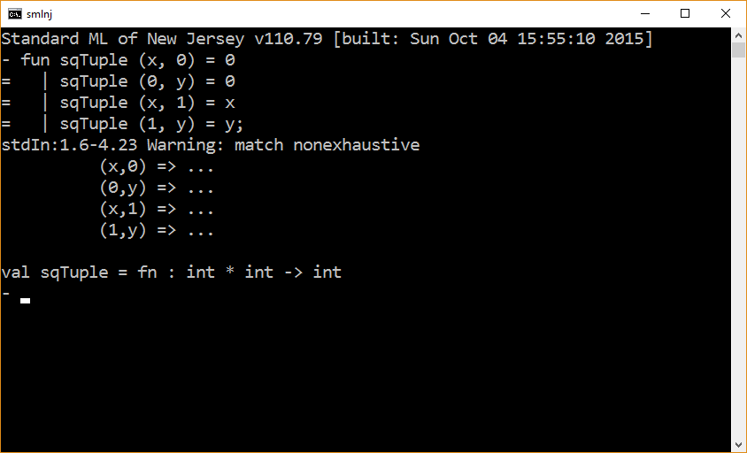

Slide 10
fun sqTuple (x, 0) = 0
| sqTuple (0, y) = 0
| sqTuple (x, 1) = x
| sqTuple (1, y) = y;
fun sqTuple2 (x, y) =
if y = 0 then 0
else if x = 0 then 0
else if y = 1 then x
else y;
fun sqTuple2 (x, y) =
if y = 0 then 0
else if x = 0 then 0
else if y = 1 then x
else if x = 1 then y
else raise exception

Slide 11
Dead code
Dead code is code that cannot be reached during execution.
if true then 42 else 5

Slide 12
Error: match redundant
fun sqTuple (x, 0) = 0
| sqTuple (x, y) = x * y
| sqTuple (0, y) = 0;
SML considers dead code arising through matching to be a compile-time error.

Slide 13
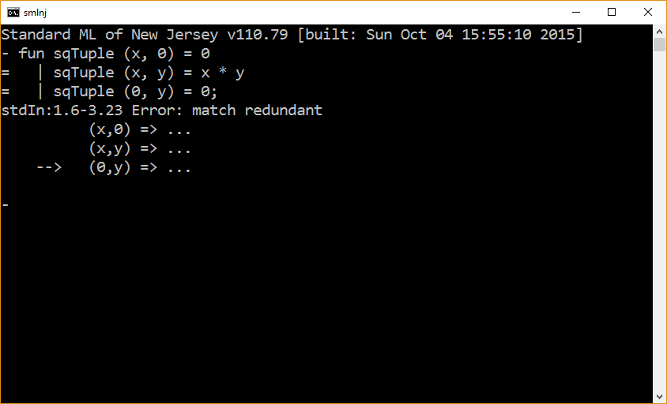

Slide 14
Functions are first class values
Binding variables to function values

Slide 15
Function values
Among other things, a hallmark of functional programming languages is that they consider function values to be first-class citizens in the language.
Function values can participate in any suitable operation. For example,
expressions can have function values as their result,
tuple elements can be function values,
a function value can be the actual parameter of a function call,
a function can return a function value as its result
Note that determining whether two functions are semantically equivalent is undecidable. Therefore, function types are not equality types.

Slide 16
Example 1
fun sq x = x * x;
val f = sq;
f 5;

Slide 17
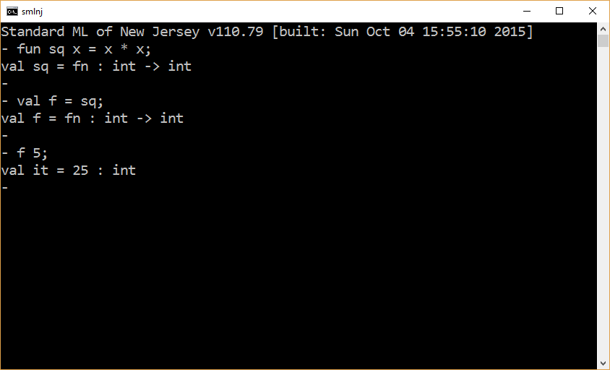

Slide 18
Example 2
fun sq x = x * x;
fun apply (f, x ) = f x;
apply (sq, 5);

Slide 19
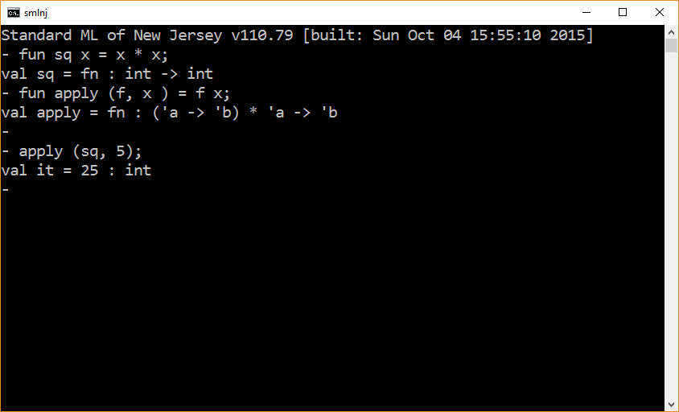

Slide 20
The end

